Slide 1


L.Aaruran
BOOTSTRAP
05.05.2024

Slide 2
Prerequisites
Basic idea about web development
Knowledge about HTML
Basic and Advanced concept/idea of CSS.

Slide 3

Learning Objectives
Colors
Typography
Image
Table
List
Text/Button

Slide 4
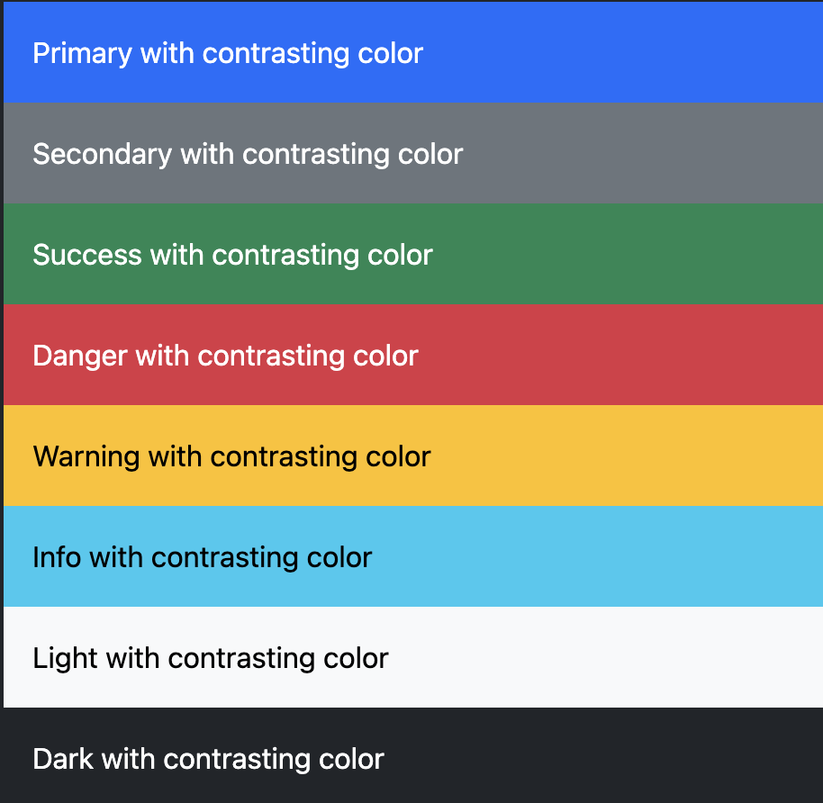
Colours

Slide 5


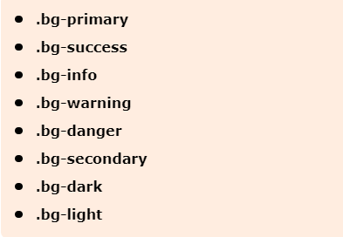
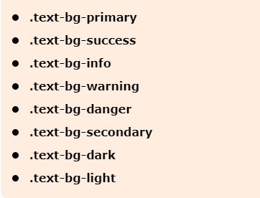
Colours
Text Colour
Background Colour

Slide 6

Typography
Heading
Display Heading
Inline text element
Blockquotes
Alignmnet
List
Inline

Slide 7
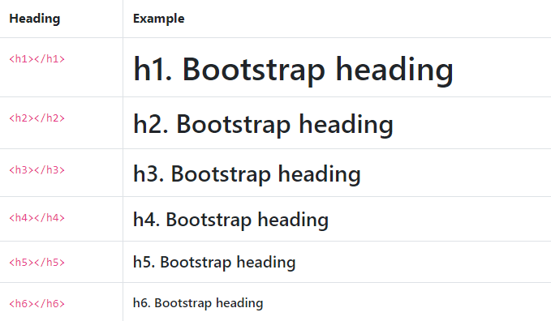
Heading

Slide 8
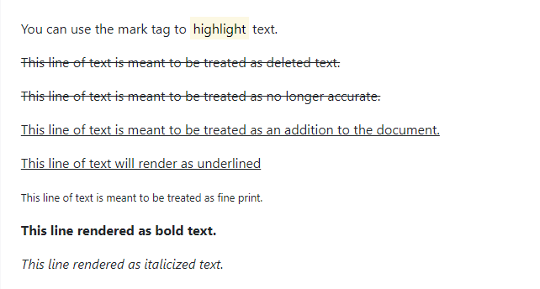
Inline text element

Slide 9
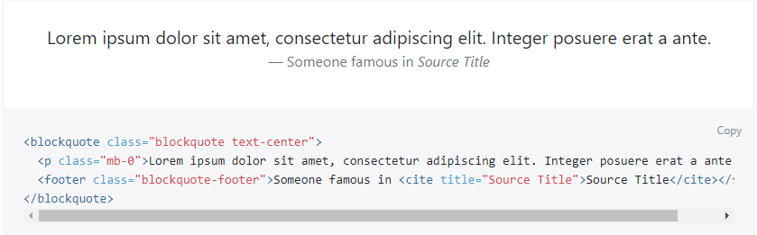
Alignment

Slide 10
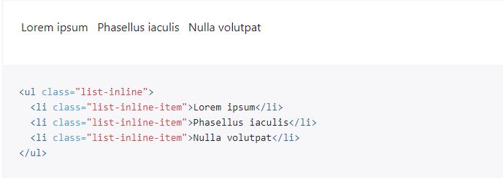
inline

Slide 11
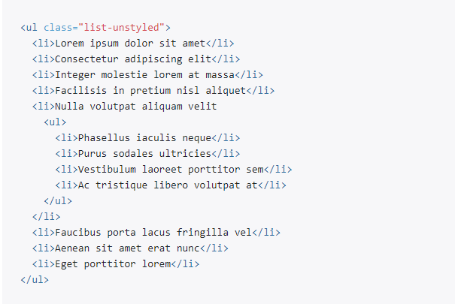
List

Slide 12
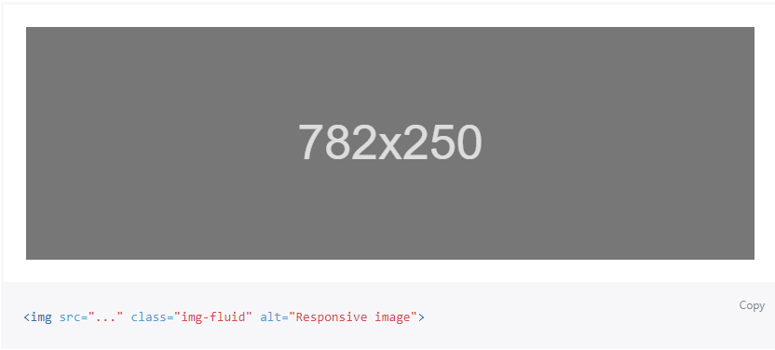
Images in Bootstrap are made responsive with .img-fluid. max-width: 100%; and height: auto; are applied to the image so that it scales with the parent element.
Image

Slide 13
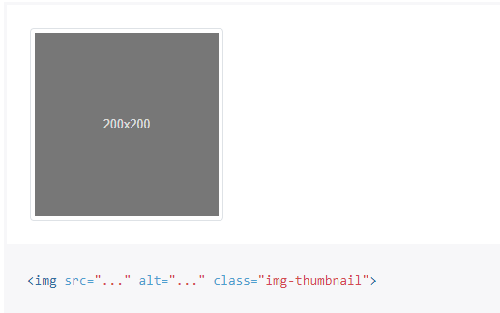
In addition to our border-radius utilities, you can use .img-thumbnail to give an image a rounded 1px border appearance.

Slide 14
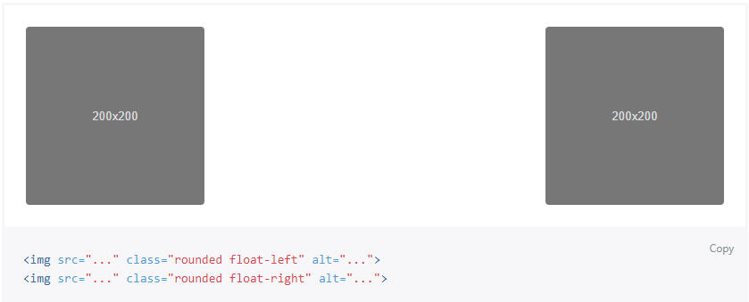
Align images with the helper float classes or text alignment classes. block-level images can be centered using the .mx-auto margin utility class.

Slide 15
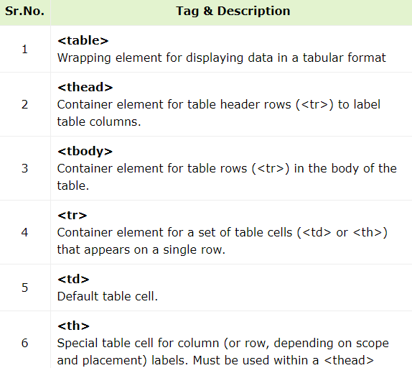
Tables is used to organize data in the form of rows and columns.
Tables

Slide 16
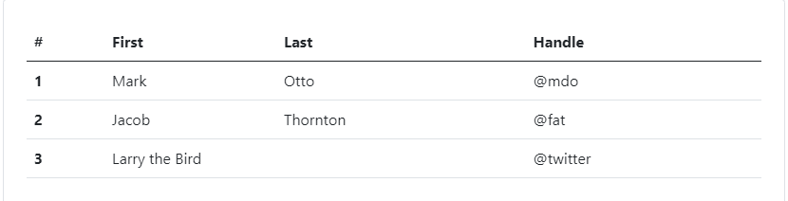
Varient Hoverable rows Active table Bordered table Tables without borders

Slide 17
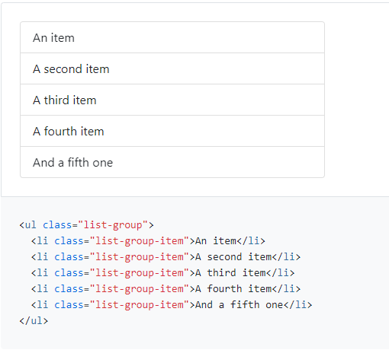
Active items Disabled items Links and buttons Numbered Checkboxes and radios
List Group

Slide 18
Text alignment Text wrapping and overflow Word break Text transform Font size Font weight and italics Text decoration
Text

Slide 19
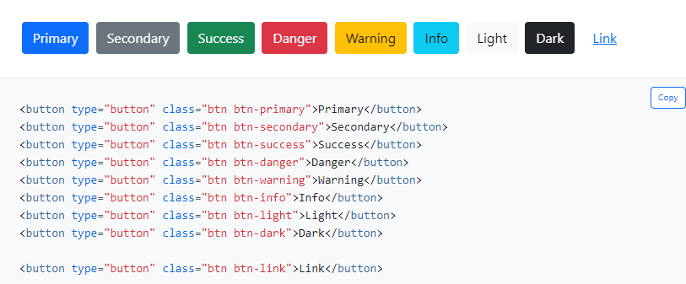
Button color Outline buttons Sizes Disabled state Block buttons
Button

Slide 20
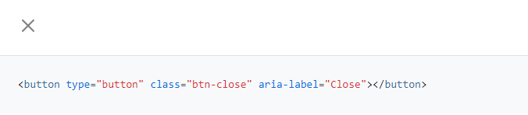
Close Button

Slide 21
Thank You

